Slide 1
Proactive Threat Detection in Kubernetes
Novel
CNIT 62300 Project Proposal
Rahul Kinnera

Slide 2
Problem Statement
Problem Statement
Legacy tools often struggle with the scale and complexity of modern networks.
Problem with facilitating collaboration of threat intelligence with live data ingestion
Why should we care
Bridging the gap between Detection and action for a comprehensive security framework.
Need for cost-effective and scalable methods for Cloud Native Environments
Notes:
Kubernetes security is multi-layered, spanning network, data, container, and infrastructure domains. Each component adds a unique layer of defense, but also introduces complexity, making it essential to adopt a holistic security strategy.
Network Security, Pod Security, Container Security, API server, Policy Enforcement
While Prometheus and Grafana are exceptional for performance and system health monitoring in Kubernetes, Zeek and MISP offer a dedicated approach to security monitoring, threat intelligence, and incident response

Slide 3
Project Timeline and Completion Plan
Completion Plan
Week 1: Gather Literature and create research questions.
Week 2-3: Setup Kubernetes Cluster with Zeek and MISP
Week 4: Perform attack and analyze results.
Gather Literature and create research questions.
Setup Kubernetes Cluster with Zeek and MISP
Perform attack and analyze results..

Slide 4
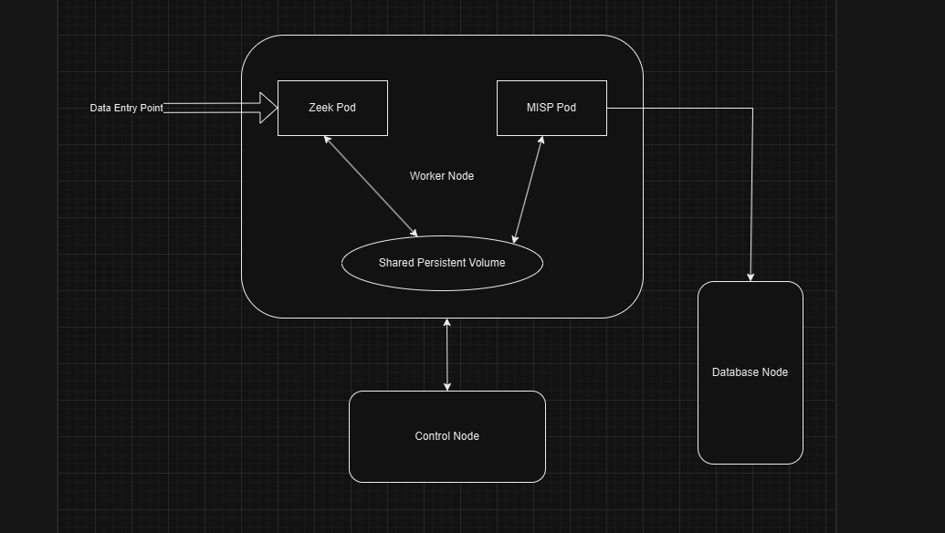
Concrete Task and System I-O
Task
Capture and Analyze network traffic using Zeek
Share PCAP and correlate threat intelligence using MISP
Ensure scalability, fault tolerance, and ease of integration using Kubernetes

Slide 5
Concrete Task and System I-O
Input and Output
Zeek Input: Live traffic from eth0 and pre-recorded PCAP files
Zeek Output: .pcap, conn.log, dns.log and http.log files
MISP Input: Output files of Zeek, Network anomaly alerts by Zeek.
MISP Output: Additional context to threat events, IoCs
Notes:
Zeek’s ability to detect anomalies, such as suspicious IP activity or unusual connection attempts, makes it ideal for identifying potential threats in real-time
MISP: Open-source threat intelligence platform designed for sharing, storing, and correlating threat data and indicators of compromise (IOCs)

Slide 6
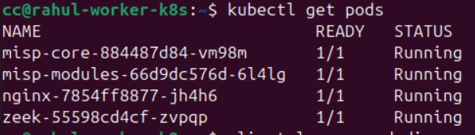
Evaluation and Progress
Performance Evaluation
Ensuring system components (Zeek, MISP) perform designated roles.
Evaluating the system’s ability to handle increasing data within the K8s cluster.
Seamless data flow and usability of Zeek and MISP
Success so far
Successful deployment of Zeek and MISP pods
Ensuring scalability in the existing infrastructure.
Integration of Zeek logs as input to MISP using API
Notes:
Zeek’s ability to detect anomalies, such as suspicious IP activity or unusual connection attempts, makes it ideal for identifying potential threats in real-time
MISP: Open-source threat intelligence platform designed for sharing, storing, and correlating threat data and indicators of compromise (IOCs)

Slide 7
Key Challenges and Future Work
Challenges faced so far
Lack of literature around implementing live threat intelligence monitoring in Kubernetes.
Resource Management and Persistent Storage Binding issues
Issues with generated Zeek Logs that were to be integrated with MISP.
Future Work
Integrating Zeek with Grafana to visualize the logs for better understanding.
Obtaining resource metrics and evaluating cost-effectiveness of the solution.

Slide 8
Questions
Note
Work in progress in terms of Week 4 deliverables experimentation and results

Slide 9
Rahul Kinnera
Graduate Student
Information Security
rkinnera@purdue.edu

